Slide 1
XG Boost
Extreme Gradient Boosting is a highly efficient boosting algorithm.
Like AdaBoost, this also creates many models sequentially one after another (mostly decision tree) and learn from its mistake from previous model and correcting it in next model.
It minimizes error using gradient descent and improving performance with speed and regularization.

Slide 2
Gradient descent
A gradient is simply a measure of how much a value changes when something else changes.
If the slope is high or upward the gradient is high/positive
If the slope is low or downward the gradient is low/negative
If the slope is flat the gradient is zero

Slide 3
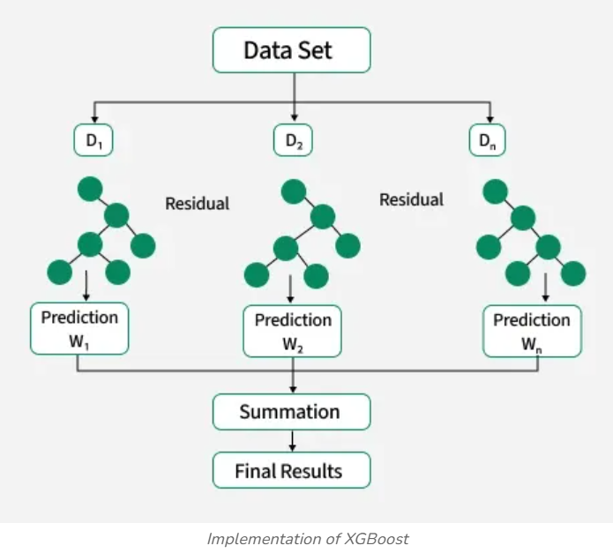
Visual Representation:

Slide 4
LG Boosting
Light Gradient Boosting Machine
High Performance open-source framework for Gradient Boosting.
It is particularly optimized for regression tasks on large datasets.
It is designed for efficiency, speed and lower memory usage compared to traditional gradient boosting algorithm.

Slide 5
